Slide 1
New layouts, data types, and architecture for GRNsight v3: a web application for visualizing gene regulatory networks
Mihir Samdarshi
Department of Biology
Loyola Marymount University
March 23, 2019
LMU Undergraduate Research Symposium

Slide 2
Outline
Gene regulatory networks (GRNs) consist of genes, transcription factors, and the regulatory relationships between them.
GRNsight is an open source web application and service for visualizing models of gene regulatory networks.
GRNsight has matured since version 1.0, adding new features such as new layout options and data types.
This has necessitated a complete refactor of GRNsight code to the Model-View-Controller paradigm, which facilitates easier user and developer interactions with the application.

Slide 3
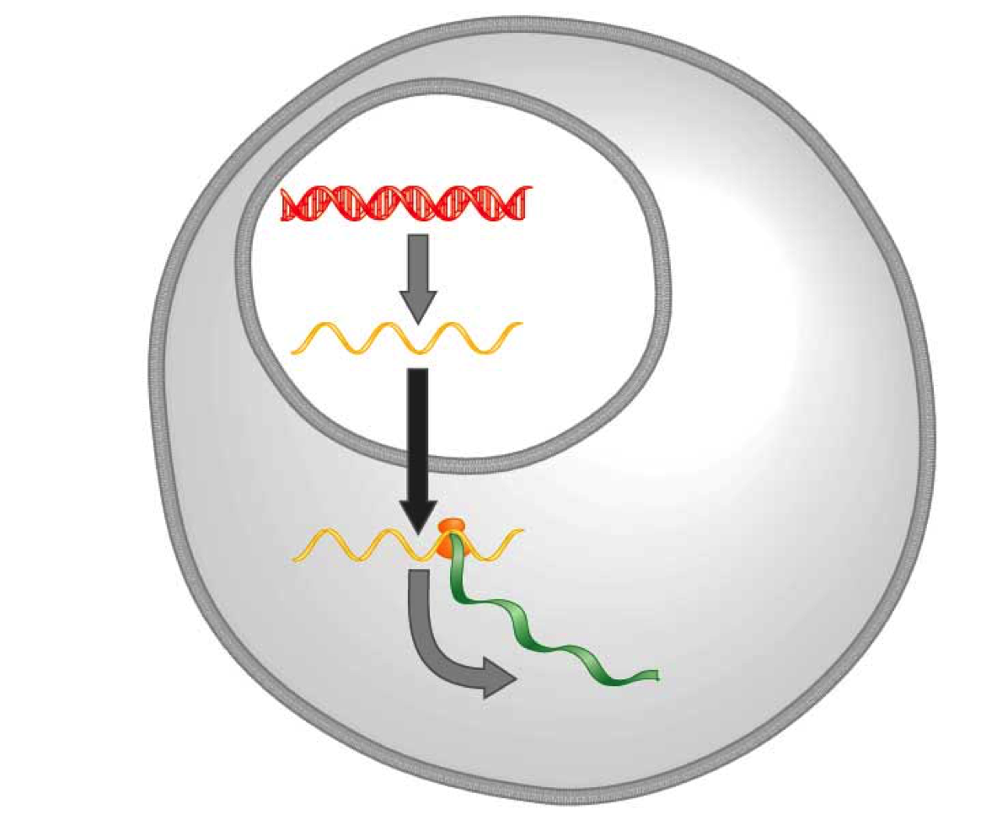
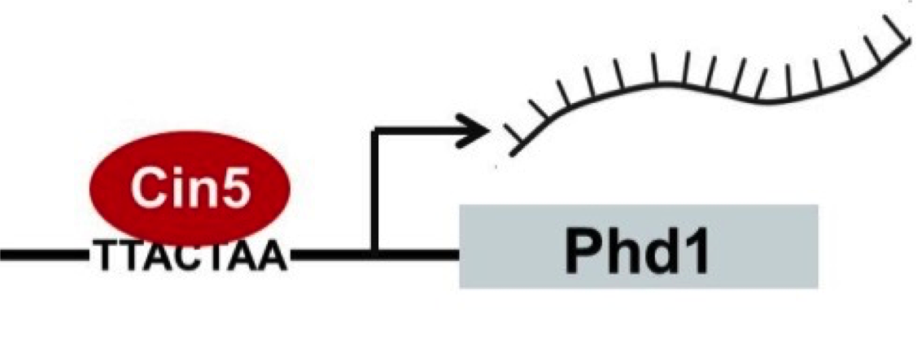
Transcription factors regulate the expression of genes
Transcription factors activate or repress expression of their target genes.
DNA
Transcription
mRNA
Translation
Protein
Gene regulatory process

Slide 4
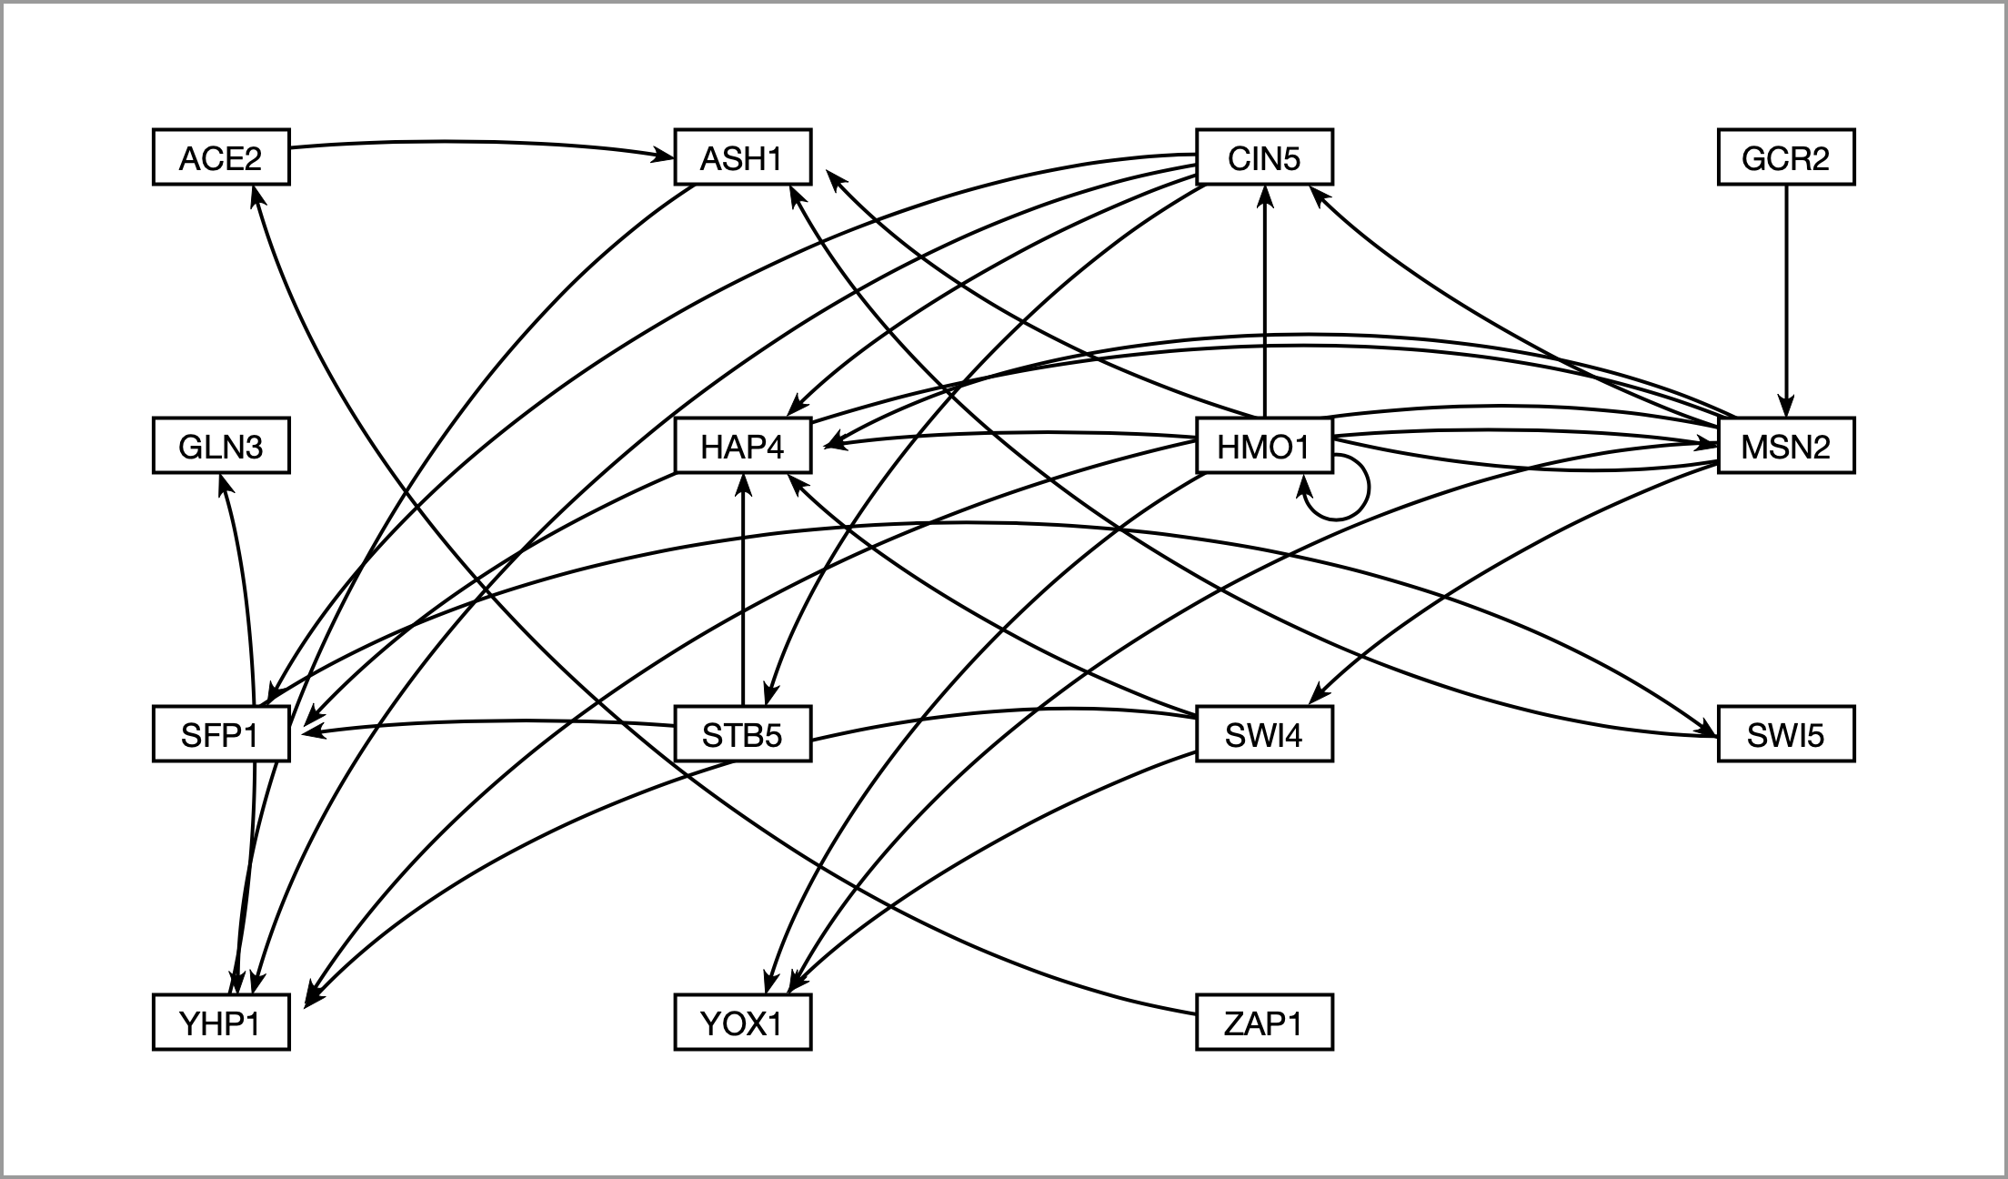
A gene regulatory network (GRN) controls the level of expression of genes and proteins
Dahlquist et al. (2015) Bulletin of Mathematical Biology 77: 1457.

Slide 5
GRNmap models the dynamics of GRNs to estimate weight parameters (w)
Magnitude of weights represent the influence of transcription factor on its target gene
Positive weights = activation of gene expression
Negative weights = repression of gene expression
Expression patterns of each individual gene are modelled by individual differential equations

Slide 6
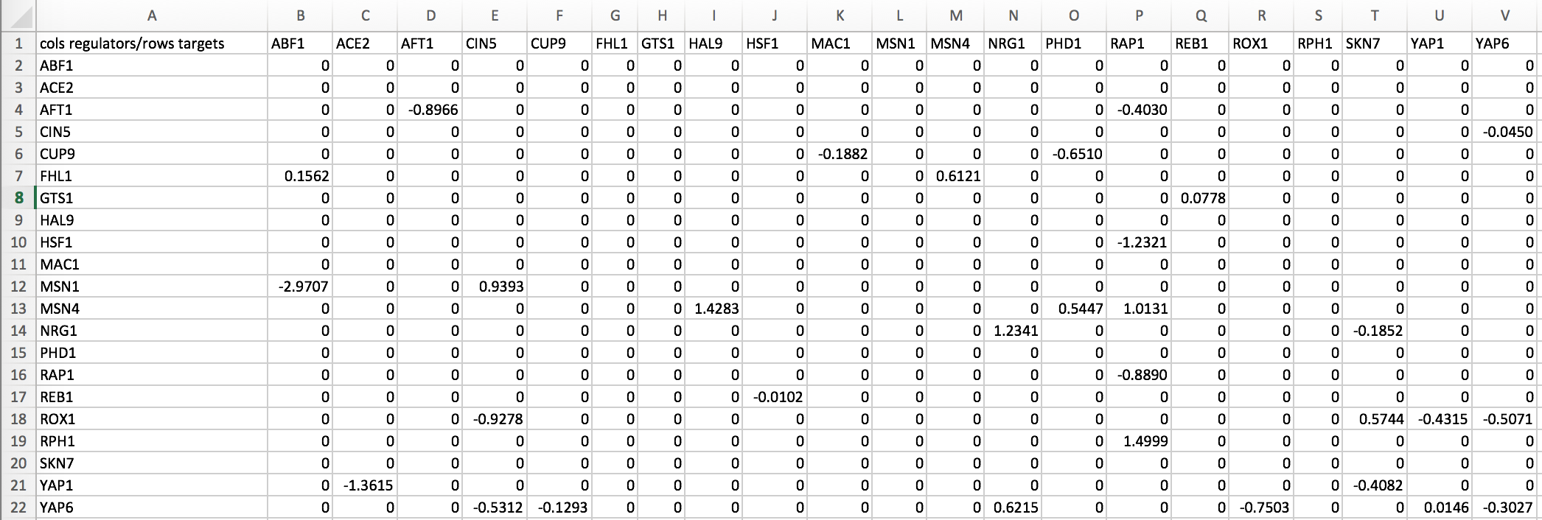
Weight values are outputted from GRNmap as an Excel spreadsheet
.xlsx
21 gene, 31 edge weighted network output from GRNmap
Notes:
Don’t be sarcastic

Slide 7
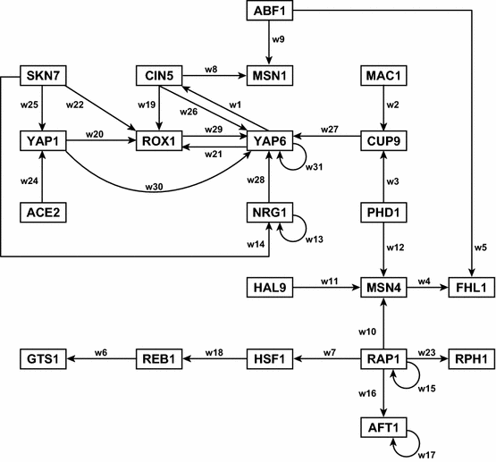
Before GRNsight, graphs would be manually plotted using Adobe Illustrator
Dahlquist et al. (2015) Bulletin of Mathematical Biology 77: 1457.

Slide 8
Cytoscrape and Gephi are examples of software for large graph visualizations
Great for overall topography
Not great for individual relationships
Emphasis on nodes
Karlari et al. (2013) PLoS One 8: E79398.
Poynter et al. (2015) BMC Cancer 15: 769.
Notes:
While this is good for overall topography, not great for individual relations, emphasis on nodes

Slide 9
GRNsight fills a niche in bioinformatics visualization software
Cytoscape and Gephi | GRNsight
Optimized for large-scale graphs. | Optimized for small- to medium- scale graphs.
Must be installed. | Exists as a web application.
Several complex features in addition to visualization. | Easy to use, and easily interpretable visualizations.
Designed to emphasize node placement | Designed to emphasize individual relationships
Notes:
Designed to look at nodes and not connections

Slide 10
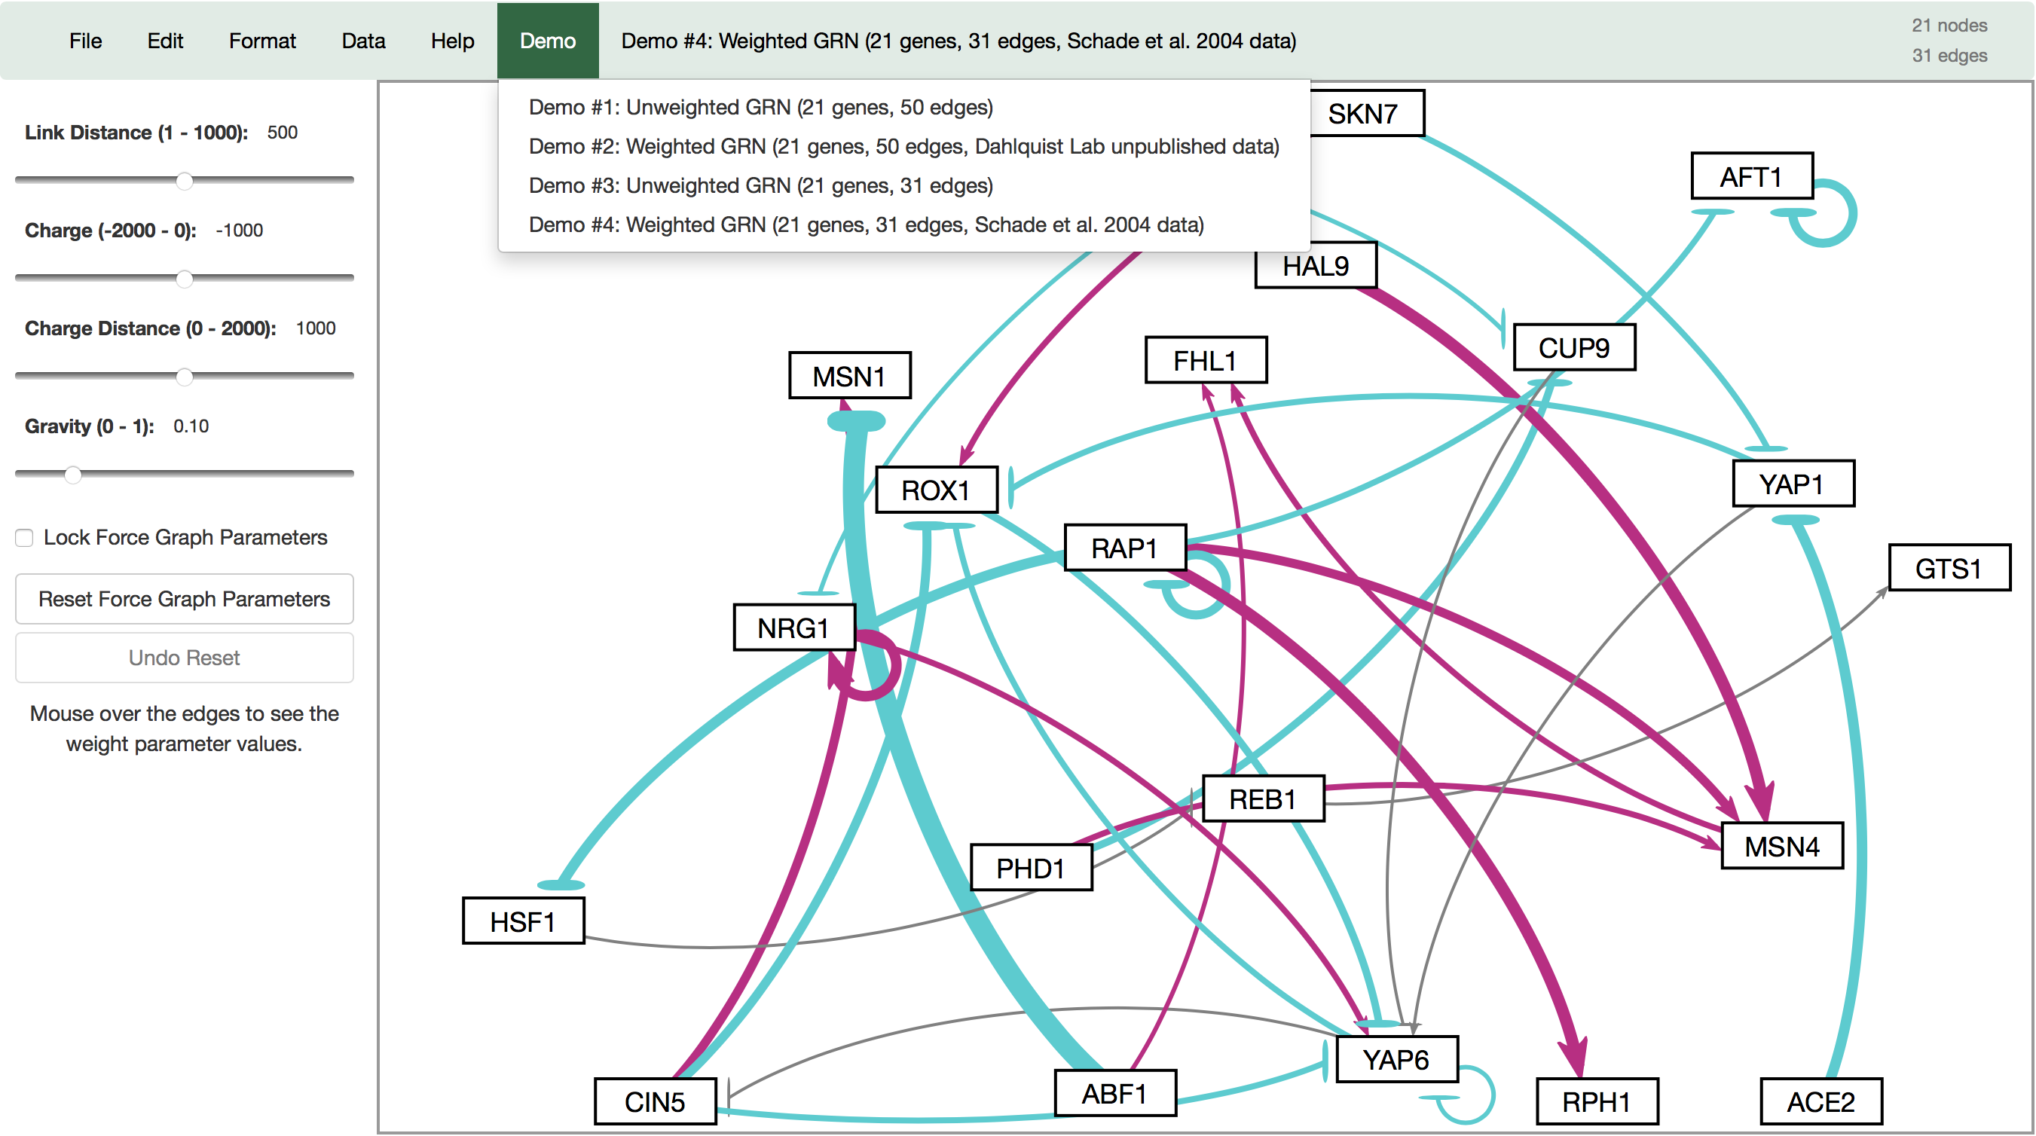
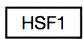
GRNsight automatically produces visualizations of weighted networks from adjacency matrix inputs
Key:
gene
activation
repression
weak influence
Screenshot of GRNsight v1, released Aug 2016
Notes:
Can easily see activation and repression

Slide 11
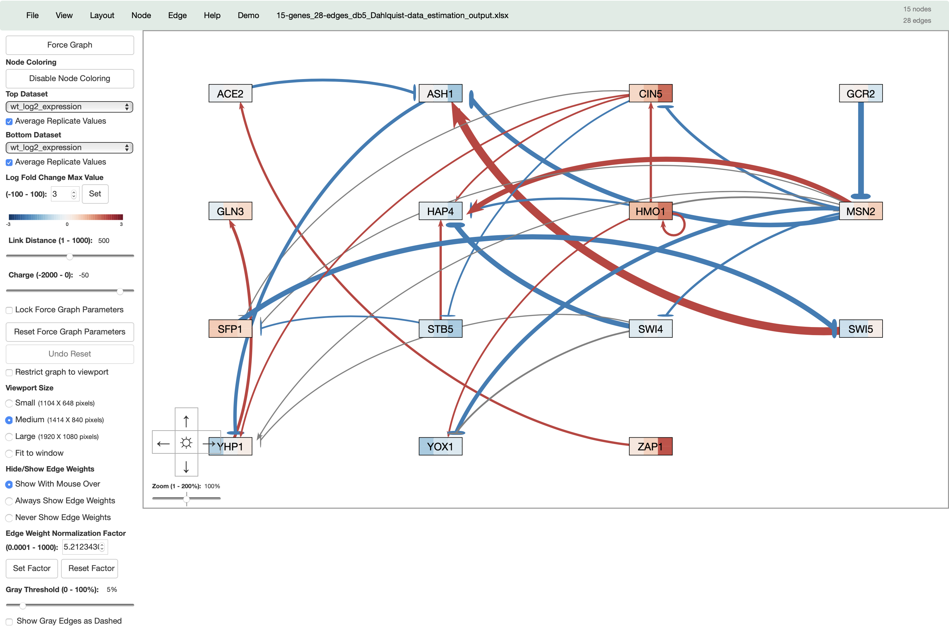


GRNsight has matured to version 3 with many new features added
Key:
gene
activation
repression
weak influence
Screenshot of GRNsight Beta v3.1.12, released February 2019

Slide 12
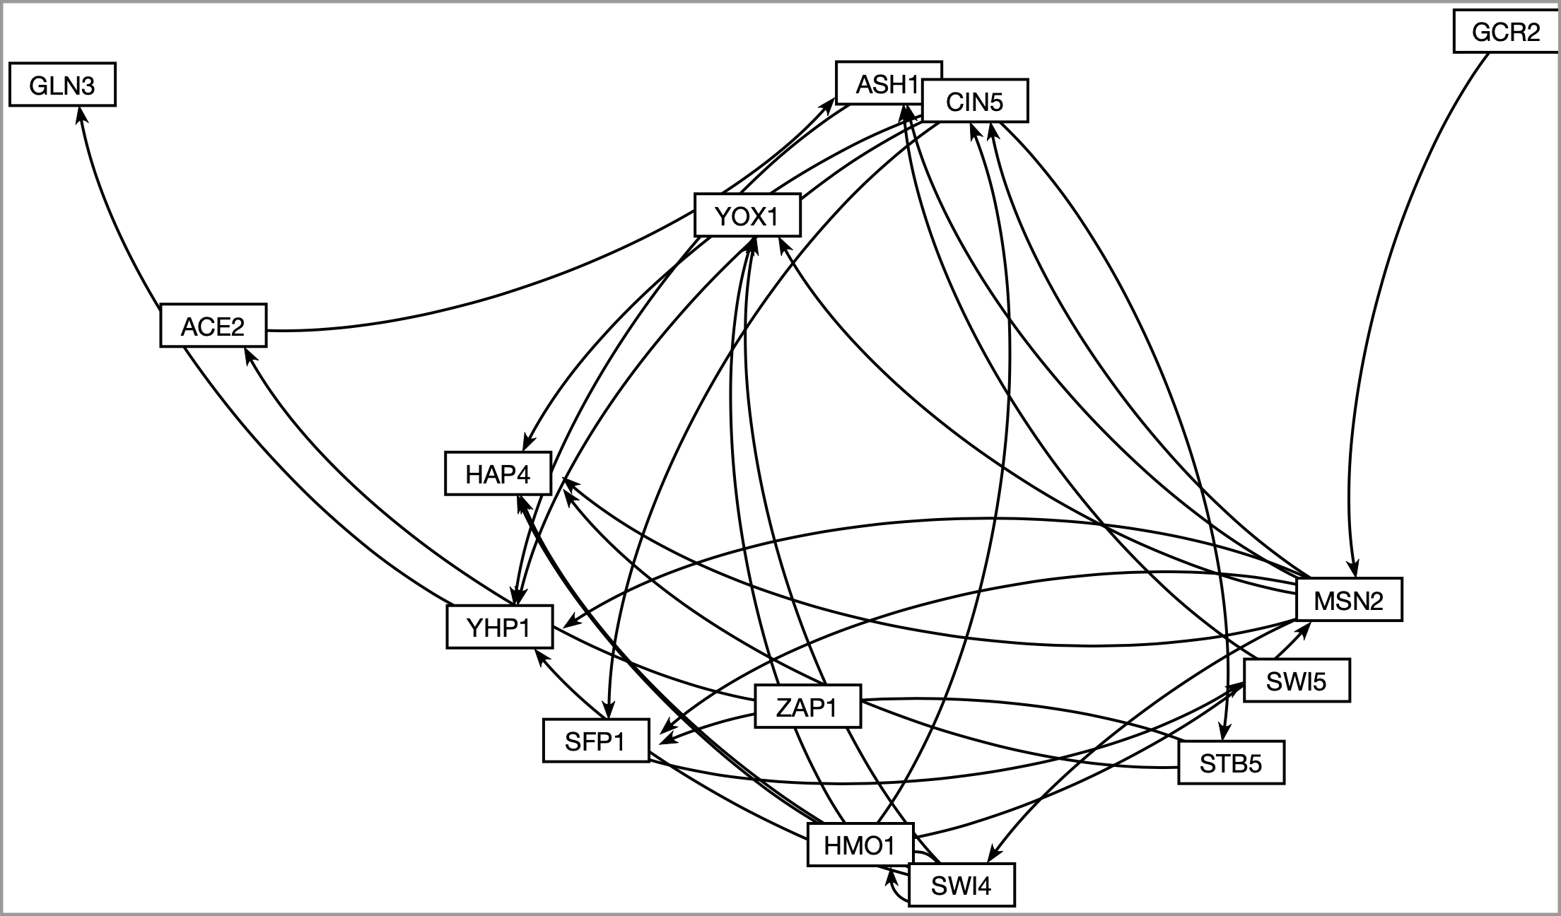
GRNsight now allows users to automatically lay out graphs in an easily readable grid format

Slide 13
GRNsight now allows users to automatically lay out graphs in an easily readable grid format

Slide 14
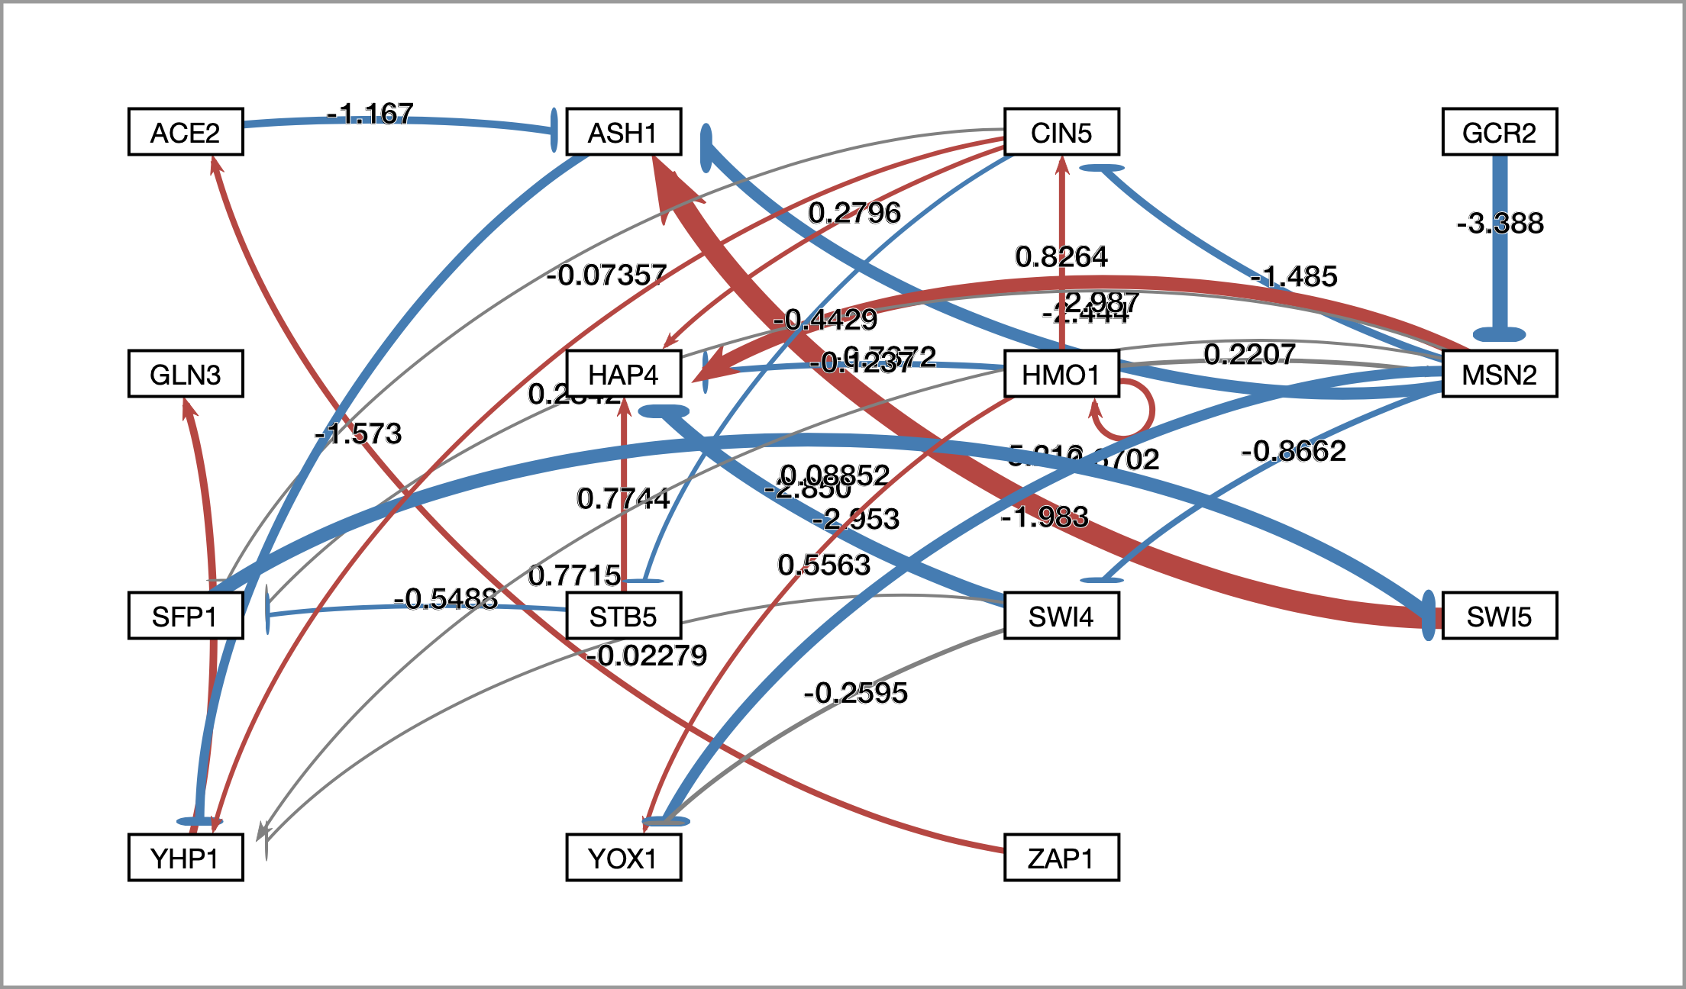
Numerical weight values can be displayed on the graph

Slide 15
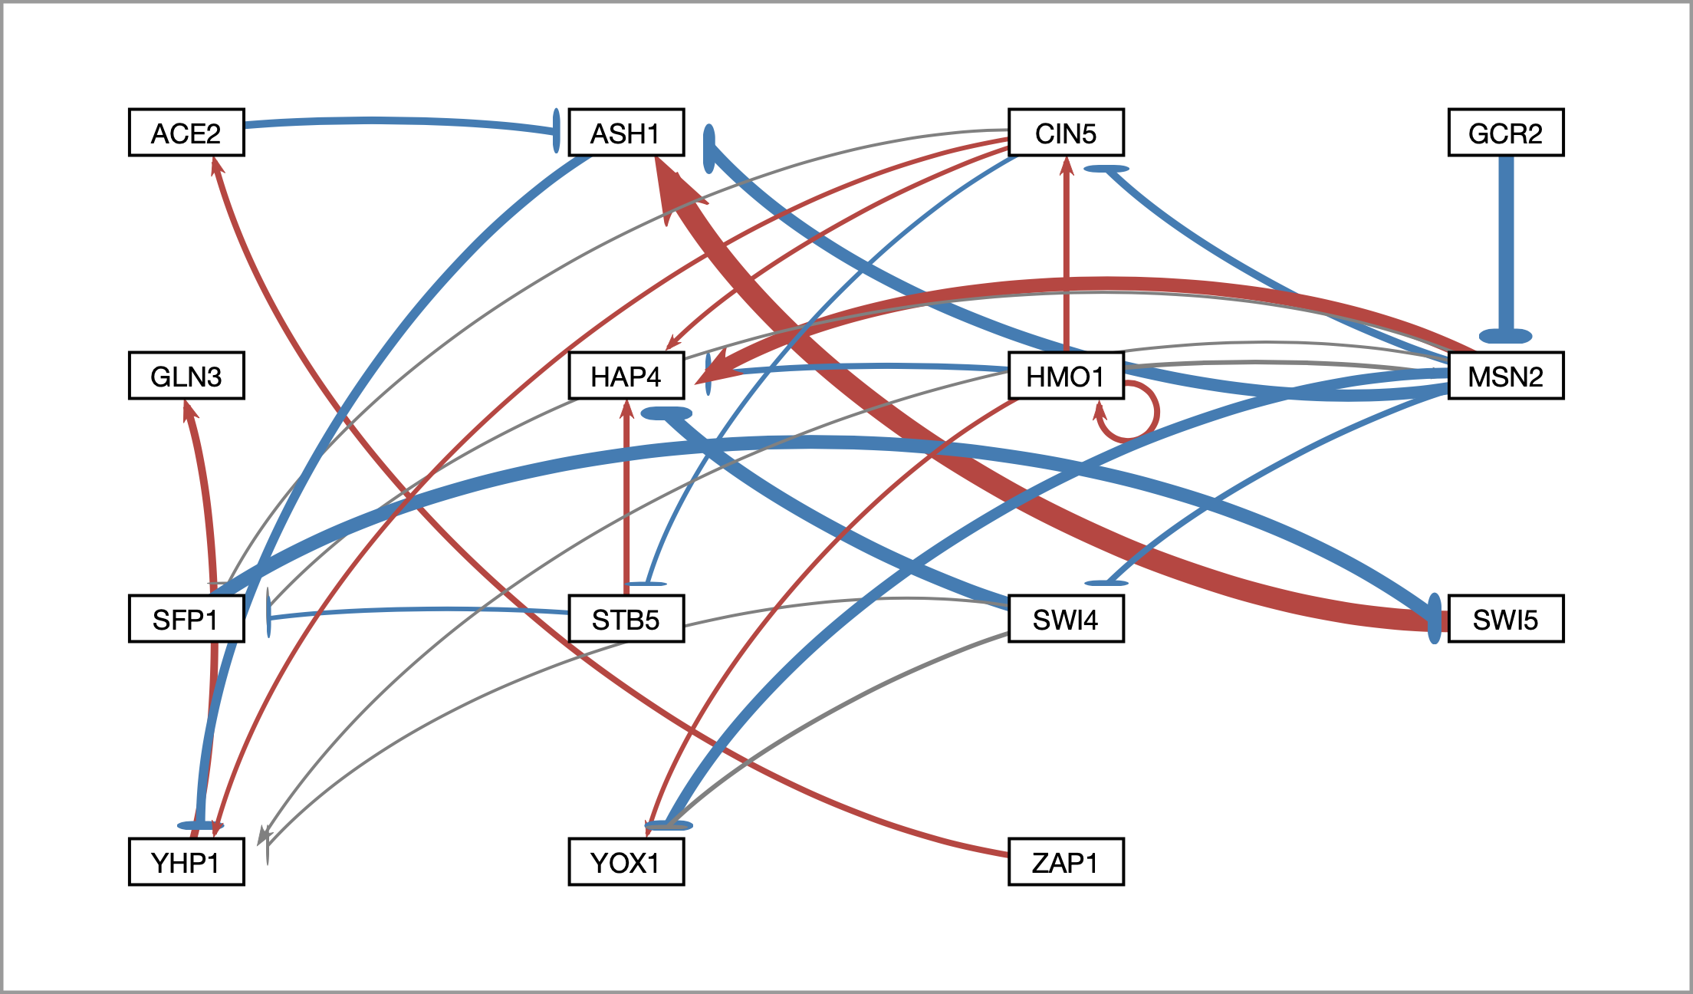
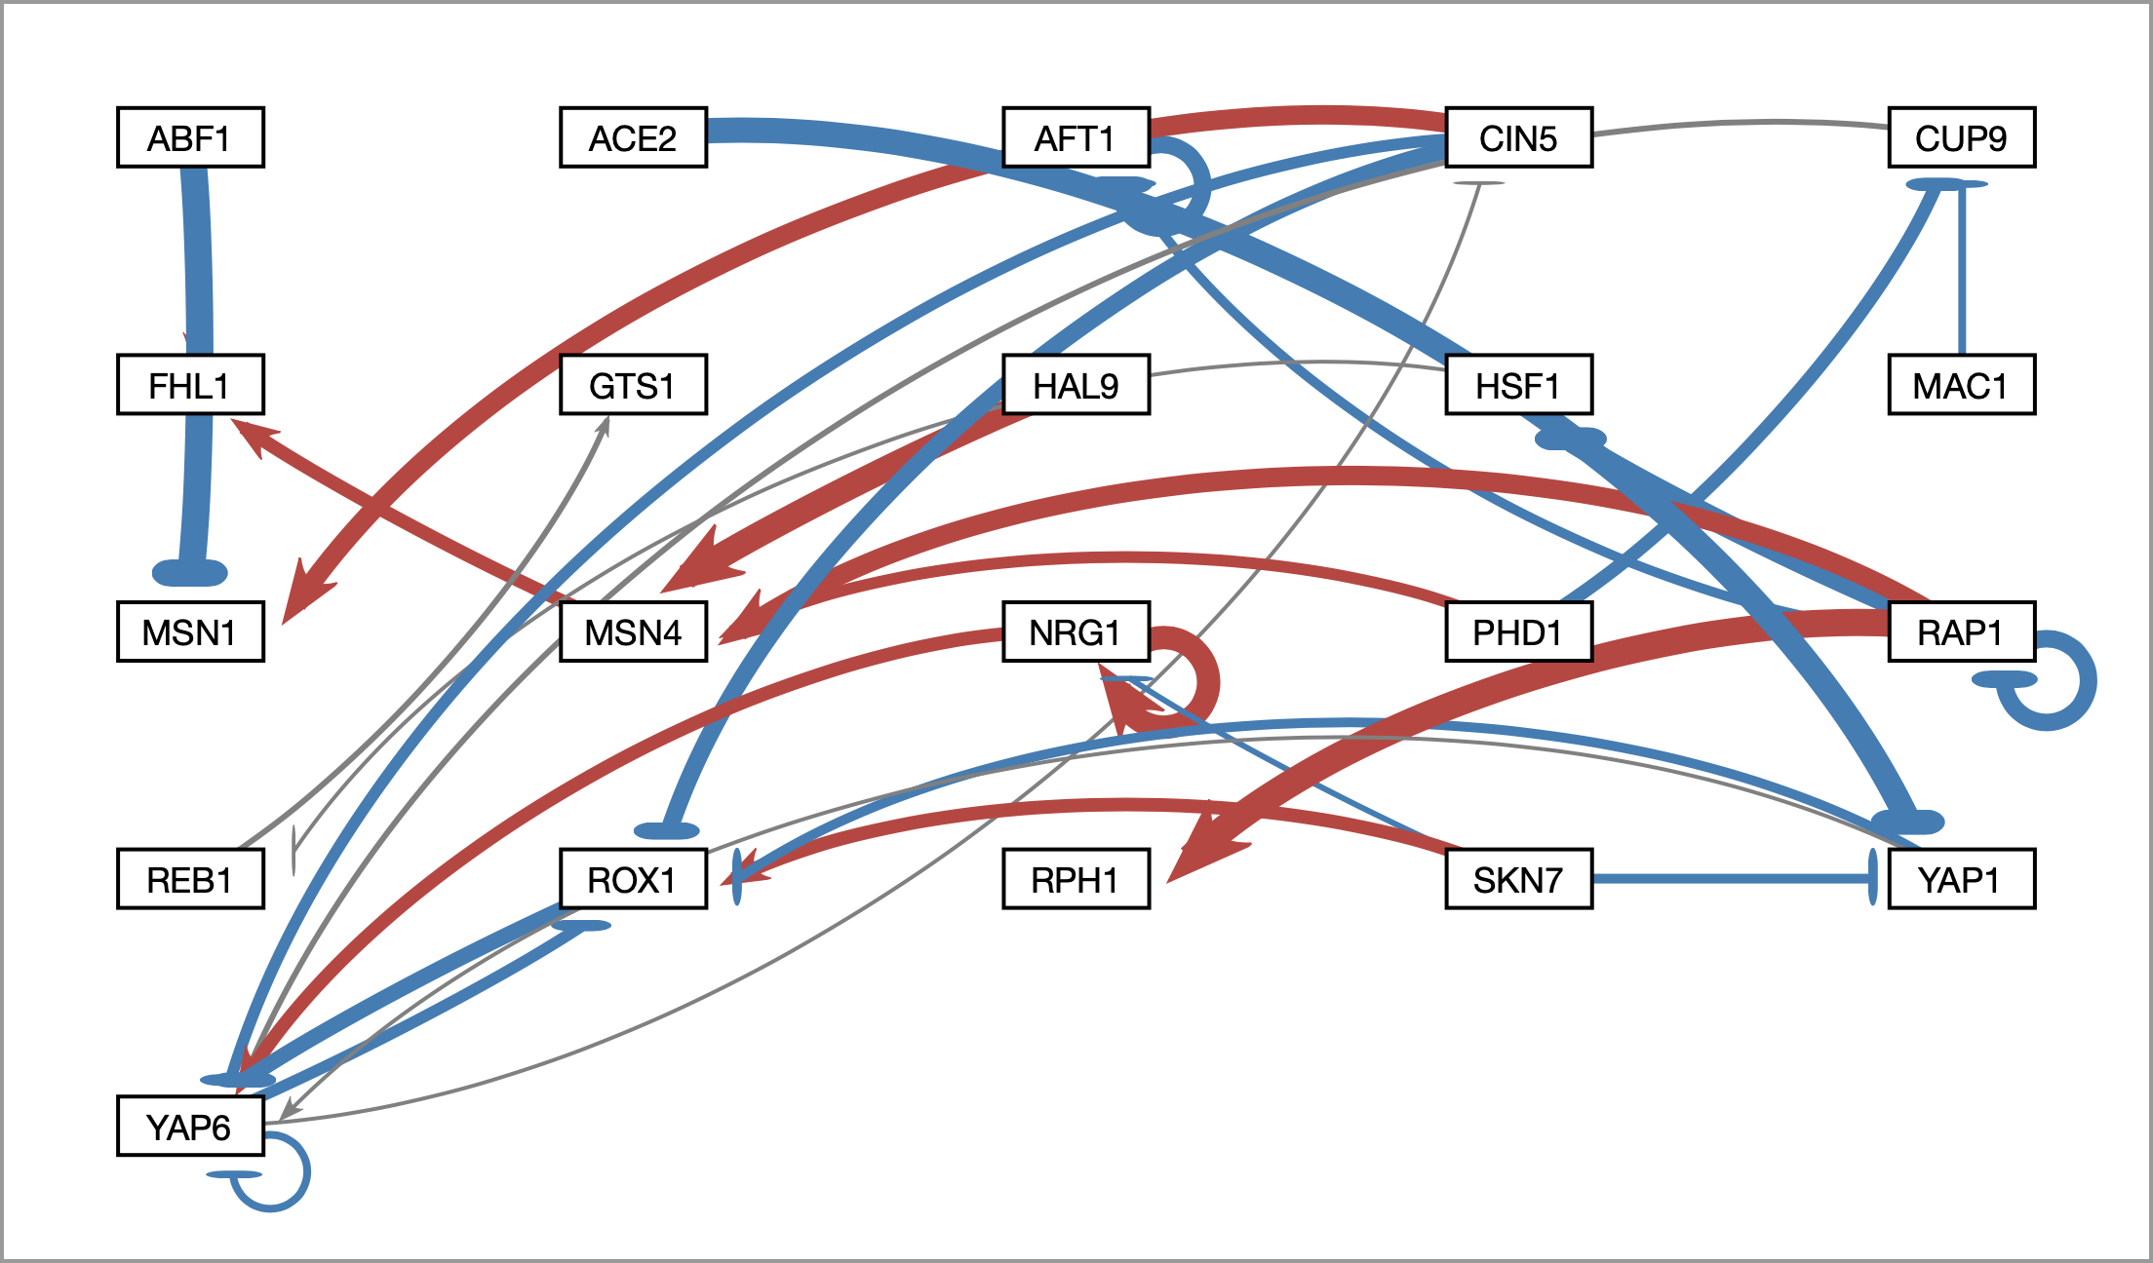
Edge thicknesses are normalized to the largest magnitude weight value
Normalization Factor = 5.21
Normalization Factor = 1.5
Edges are drawn relative to the highest magnitude edge weight, thus in order to facilitate accurate comparison between different graphs with different highest magnitude edge weight, the normalization factor may be changed.
To facilitate better comparison of graphs, users may now modulate normalization factor

Slide 16
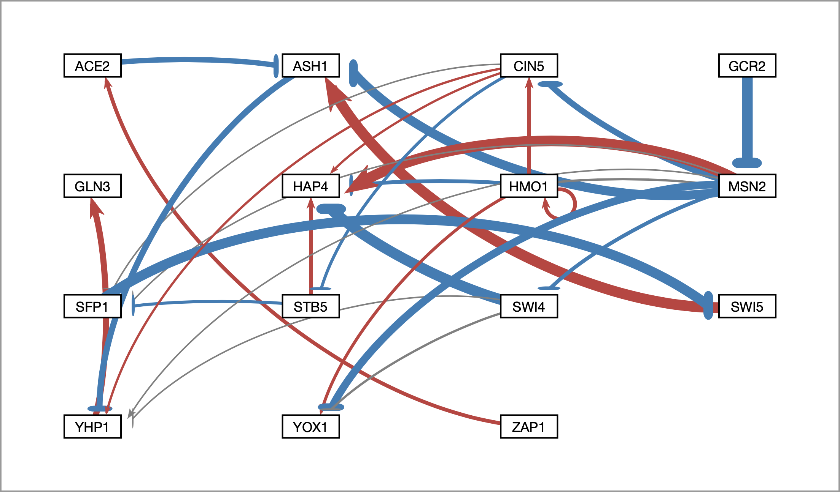
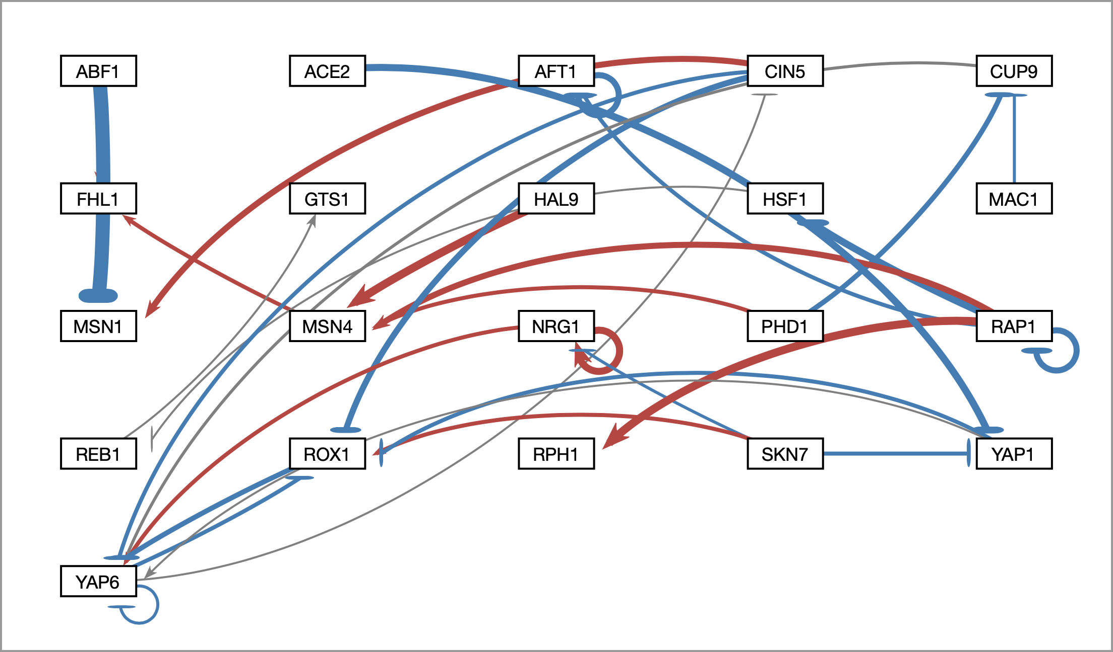
Edge thicknesses are normalized to the largest magnitude weight value
Normalization Factor = 3
Normalization Factor = 3
Edges are drawn relative to the highest magnitude edge weight, thus in order to facilitate accurate comparison between different graphs with different highest magnitude edge weight, the normalization factor may be changed.
To facilitate better comparison of graphs, users may now modulate normalization factor
Notes:
Explain what normalization is and why it is important
Add second demo with different normalizations, and then the same normalization

Slide 17
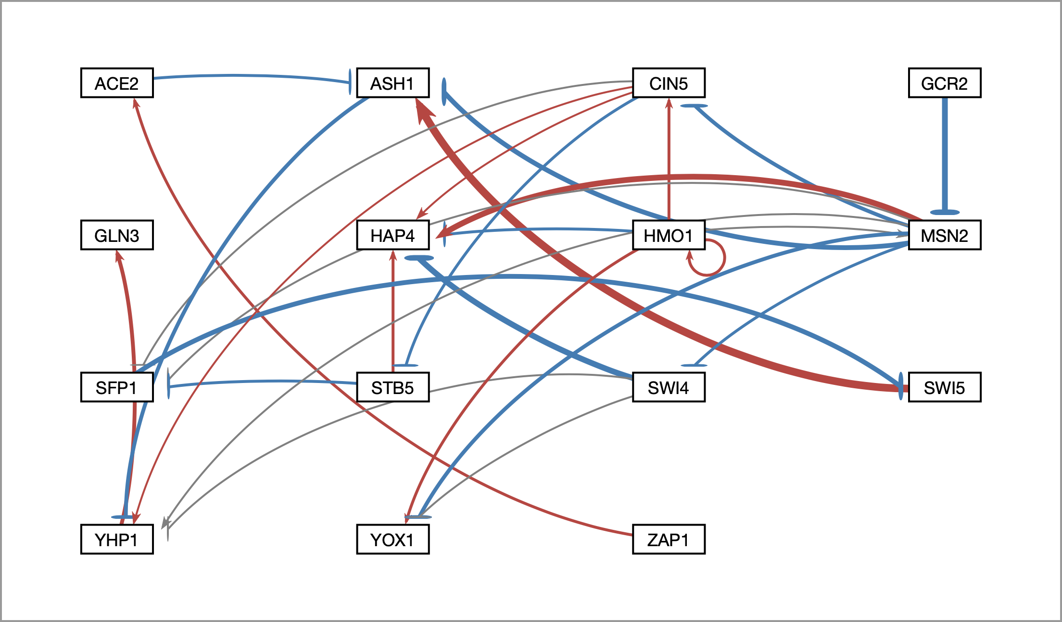
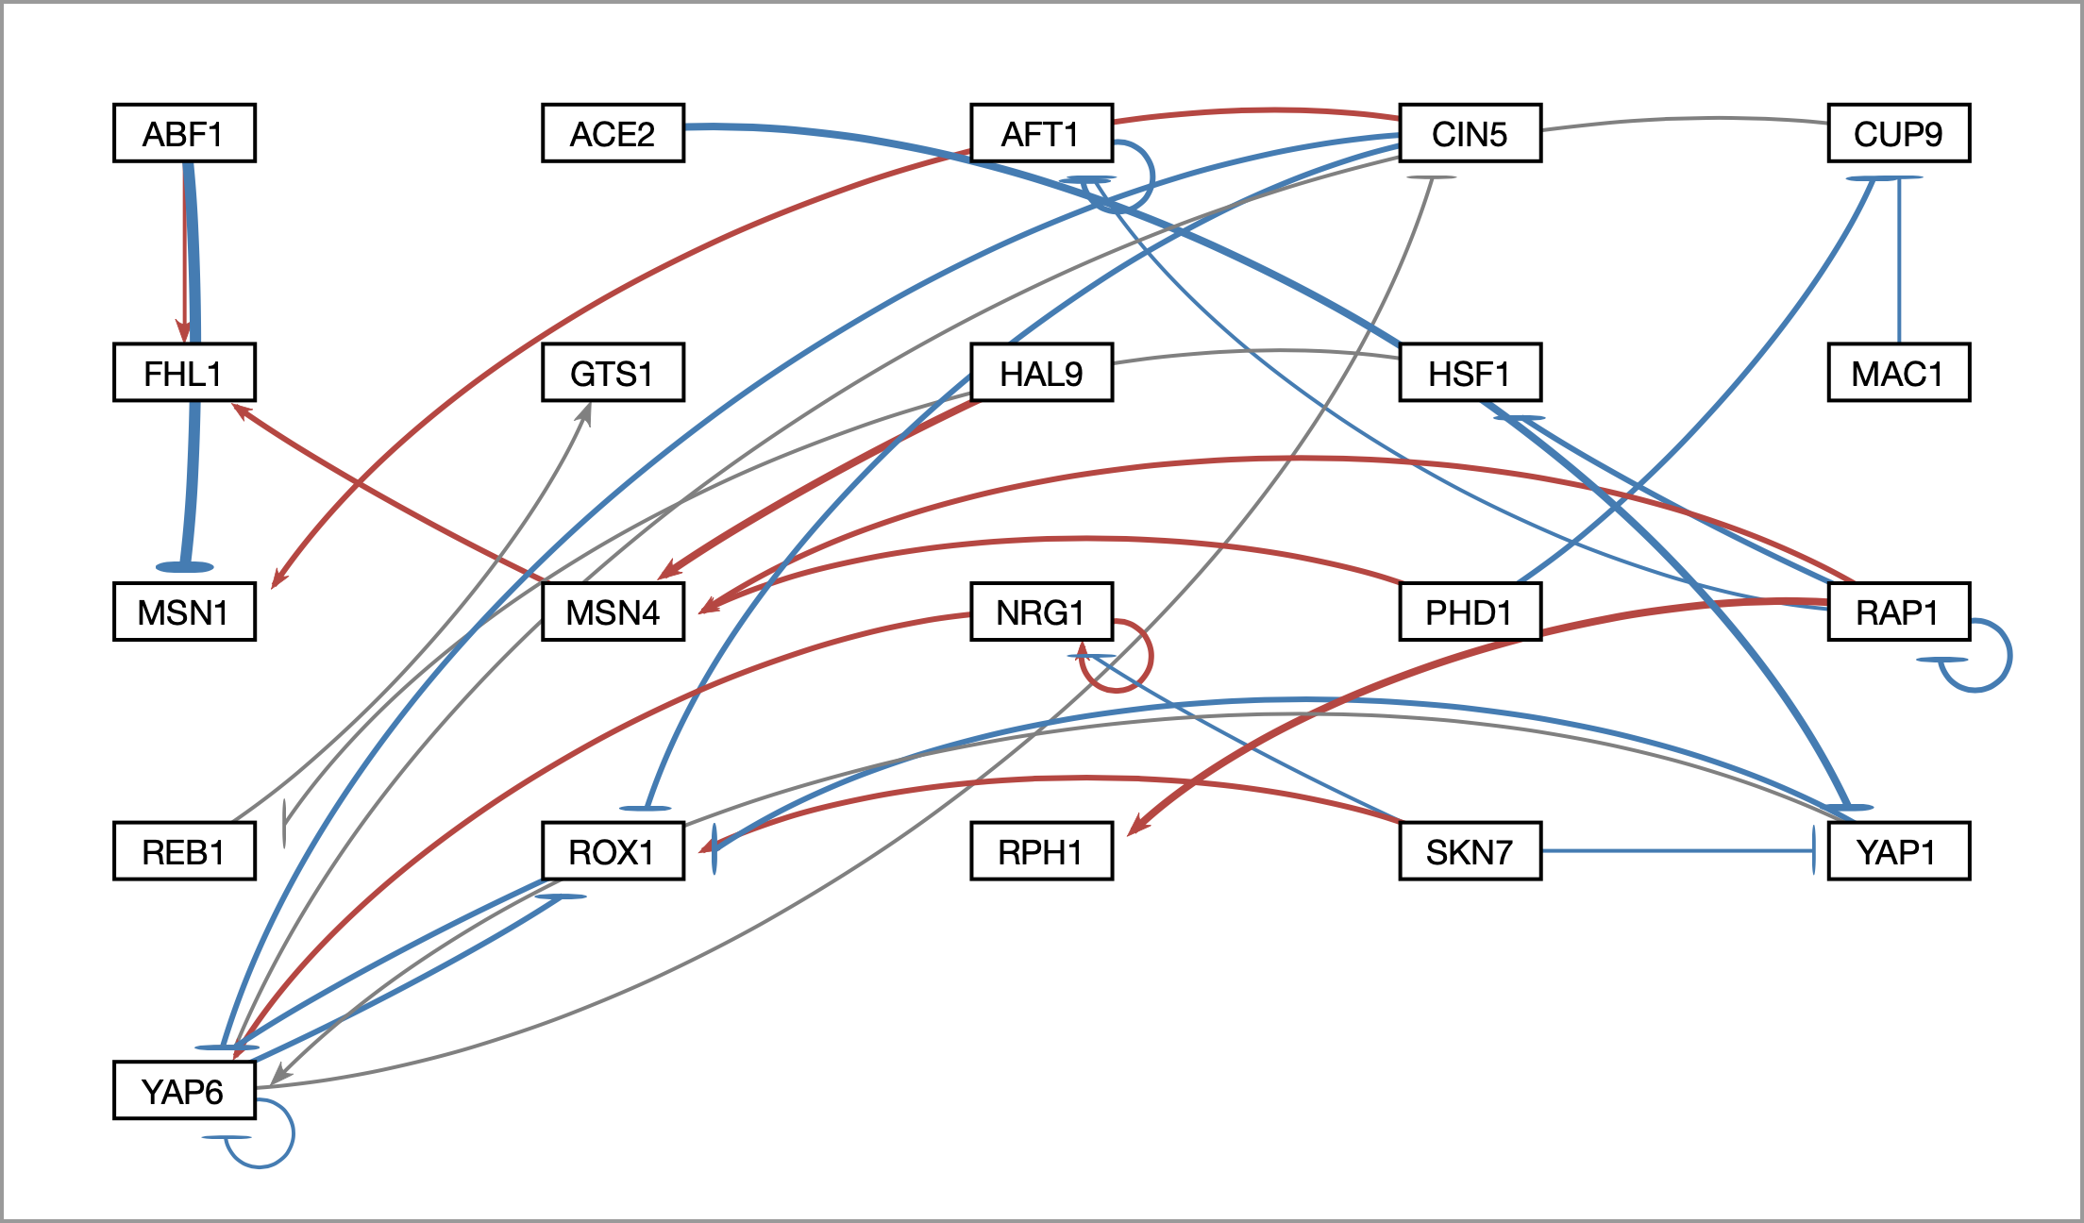
Edge thicknesses are normalized to the largest magnitude weight value
Normalization Factor = 10
Normalization Factor = 10
Edges are drawn relative to the highest magnitude edge weight, thus in order to facilitate accurate comparison between different graphs with different highest magnitude edge weight, the normalization factor may be changed.
To facilitate better comparison of graphs, users may now modulate normalization factor
Notes:
Explain what normalization is and why it is important
Add second demo with different normalizations, and then the same normalization

Slide 18
Edges with normalized weight values within 5% of 0 are displayed as gray to minimize their visual strength
To allow users to direct attention to certain nodes, users may now adjust gray edge threshold
Gray Edge Threshold = 5%

Slide 19
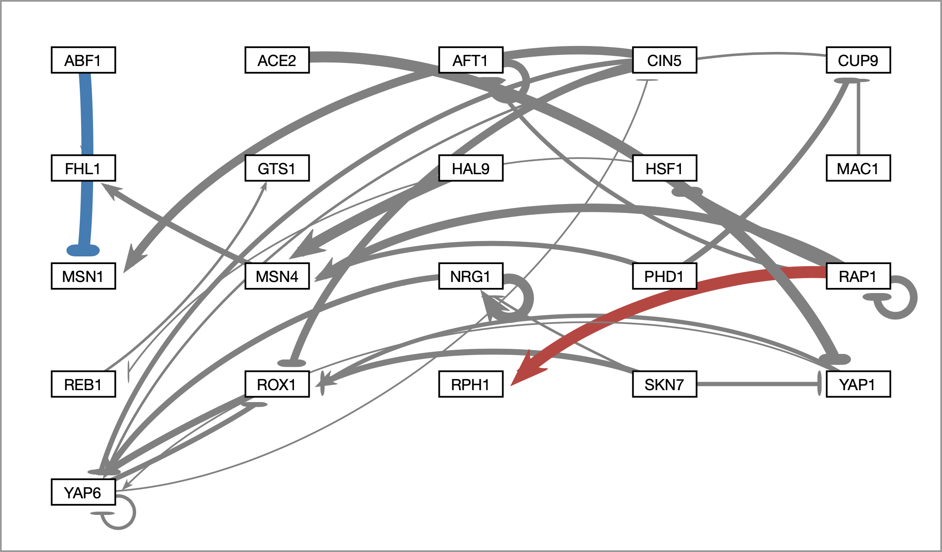
Users can change the gray edge threshold with a slider
To allow users to direct attention to certain nodes, users may now adjust gray edge threshold
Gray Edge Threshold = 50%

Slide 20
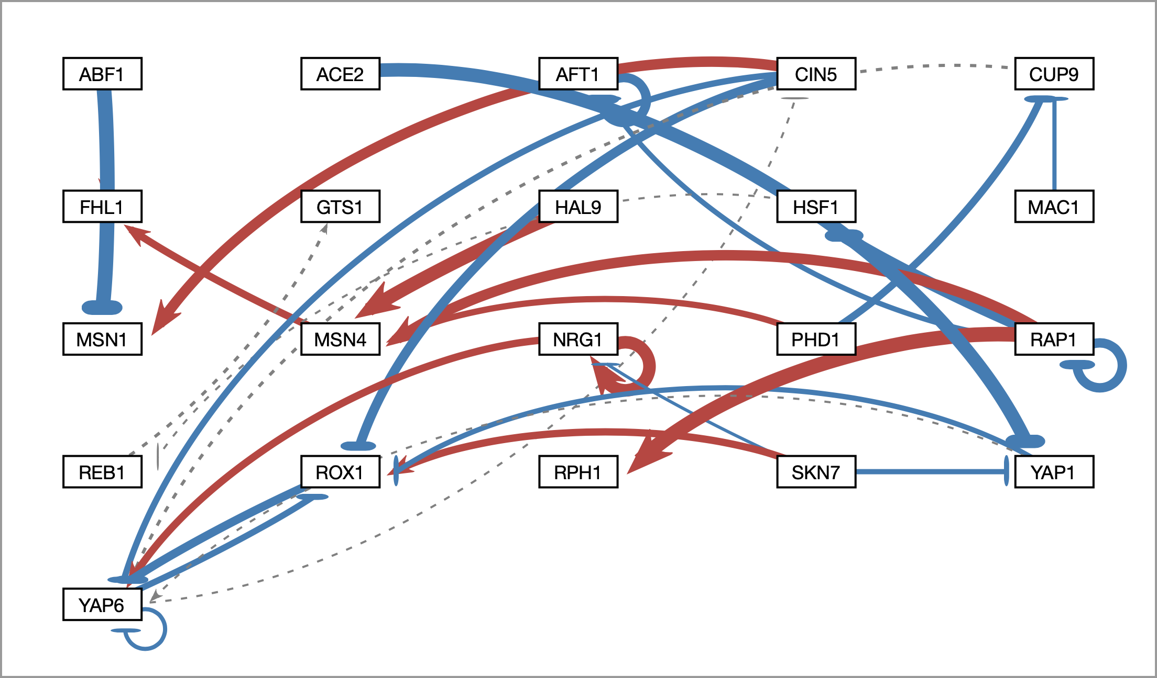
Gray edges can also be shown as dashed lines to facilitate visualization by color blind users
As a benefit to visually impaired users, gray edges may be displayed as dashed lines
Gray Edge Threshold = 5%

Slide 21
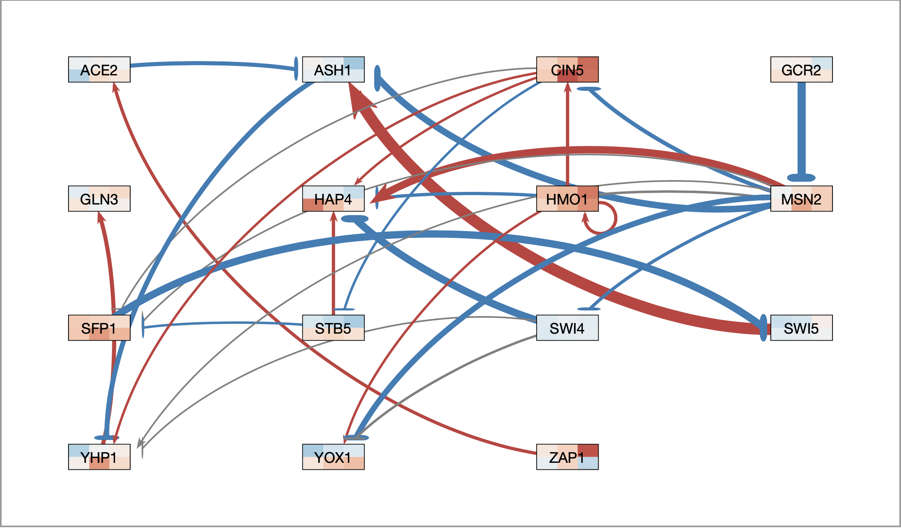
Nodes now display measured and/or simulated expression data as individual heat maps
Top = wild type microarray data
Bottom = Δ gln3 microarray data
Notes:
HMO1 is activating CIN5, and thus can see timecourse relationship

Slide 22
Nodes now display measured and/or simulated expression data as individual heat maps
Top = wild type microarray data
Bottom = Δ gln3 microarray data
Notes:
HMO1 is activating CIN5, and thus can see timecourse relationship

Slide 23
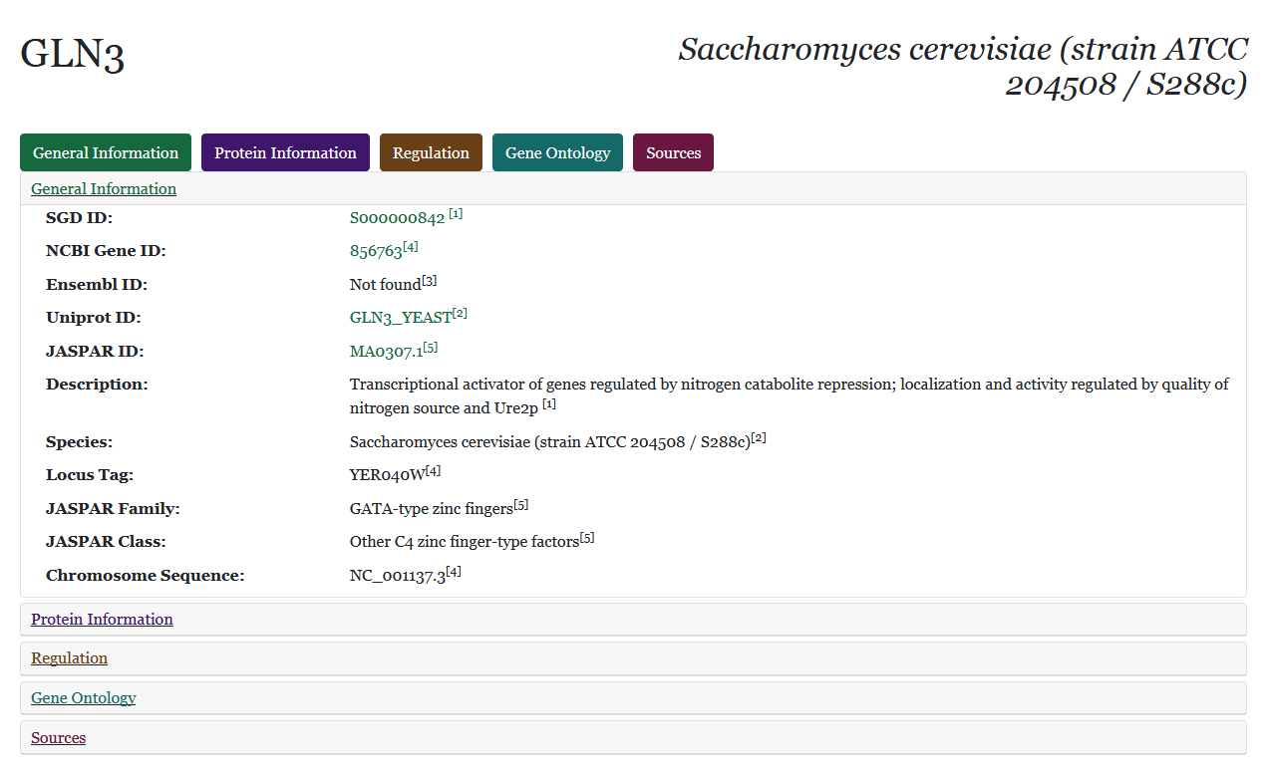
Right-clicking on a node opens a web page which displays information retrieved from various databases

Slide 24
However…
In the past 5 years:
GRNsight’s codebase has expanded nearly 10x
13 new features have been added
11 different developers have worked on GRNsight
Lead to application instability, user interaction bugs
Notes:
Add number of developers

Slide 25
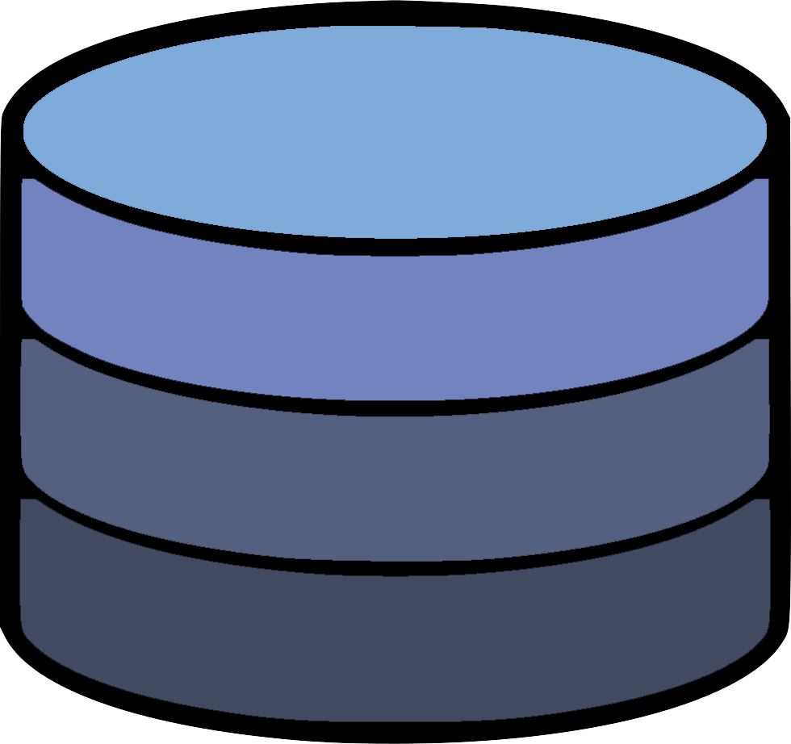
The Model-View-Controller paradigm is an architectural pattern used for developing user interfaces
Model
Updates
Manipulates
View
Controller
Displays To
Uses
User

Slide 26
The Model-View-Controller paradigm is an architectural pattern used for developing user interfaces
Creates separation of internal representations of information from the ways information is presented to and accepted from the user
Decouples the various components that comprise a complex application like GRNsight
Model
Updates
Manipulates
View
Controller
Displays To
Uses
User

Slide 27
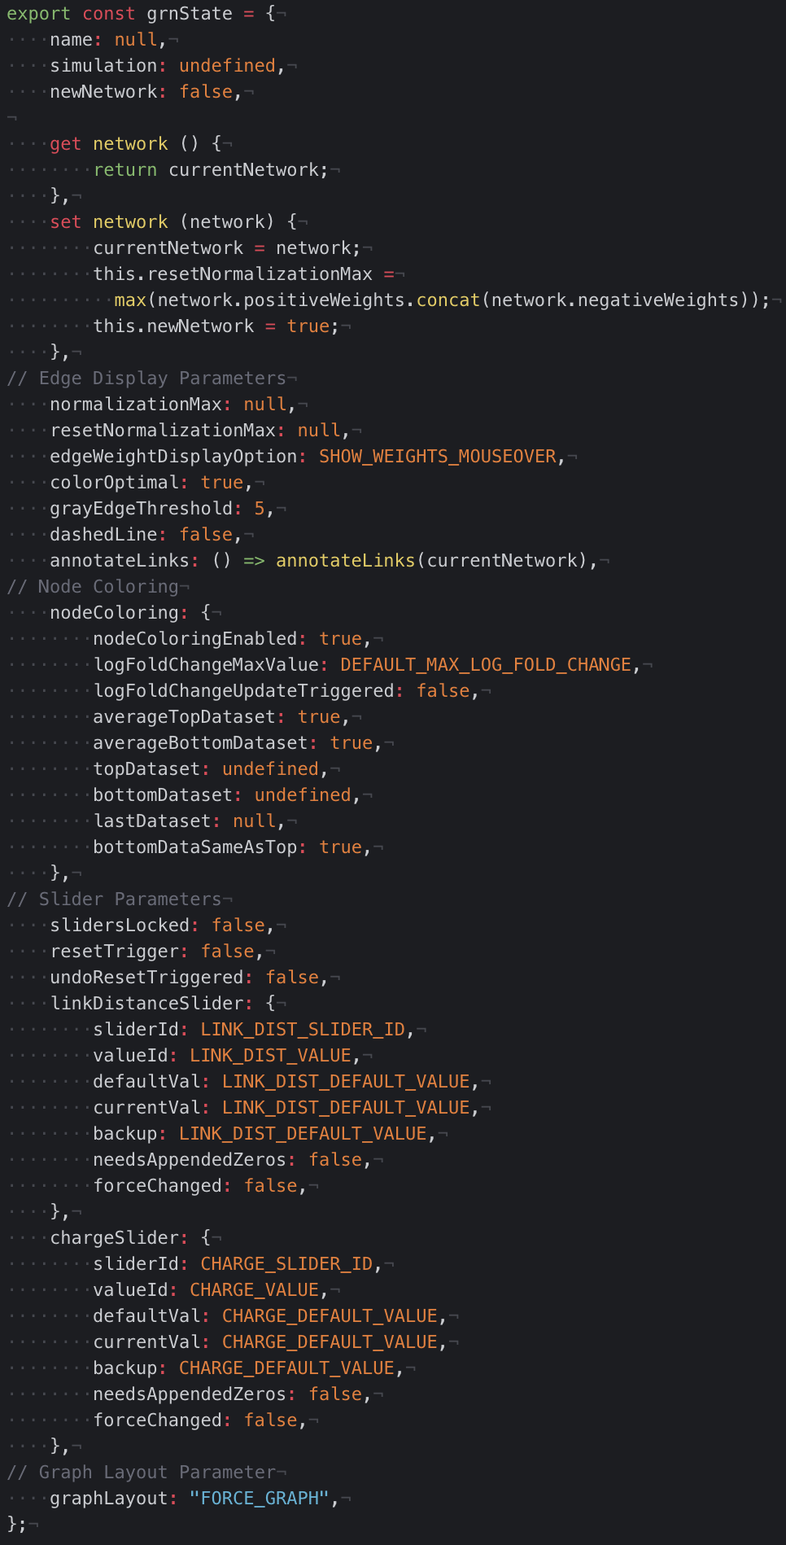
Why the MVC architecture?
Central store for application state & increased modularity:
Reducing application state conflicts
Diagnosing a bug
Adding a new feature

Slide 28
GRNsight’s new central architectural pattern
grnstate.js
Model
Updates
Manipulates
update-app.js
View
Controller
setup-handlers.js
Displays To
Uses
User
12 files → 6 files

Slide 29
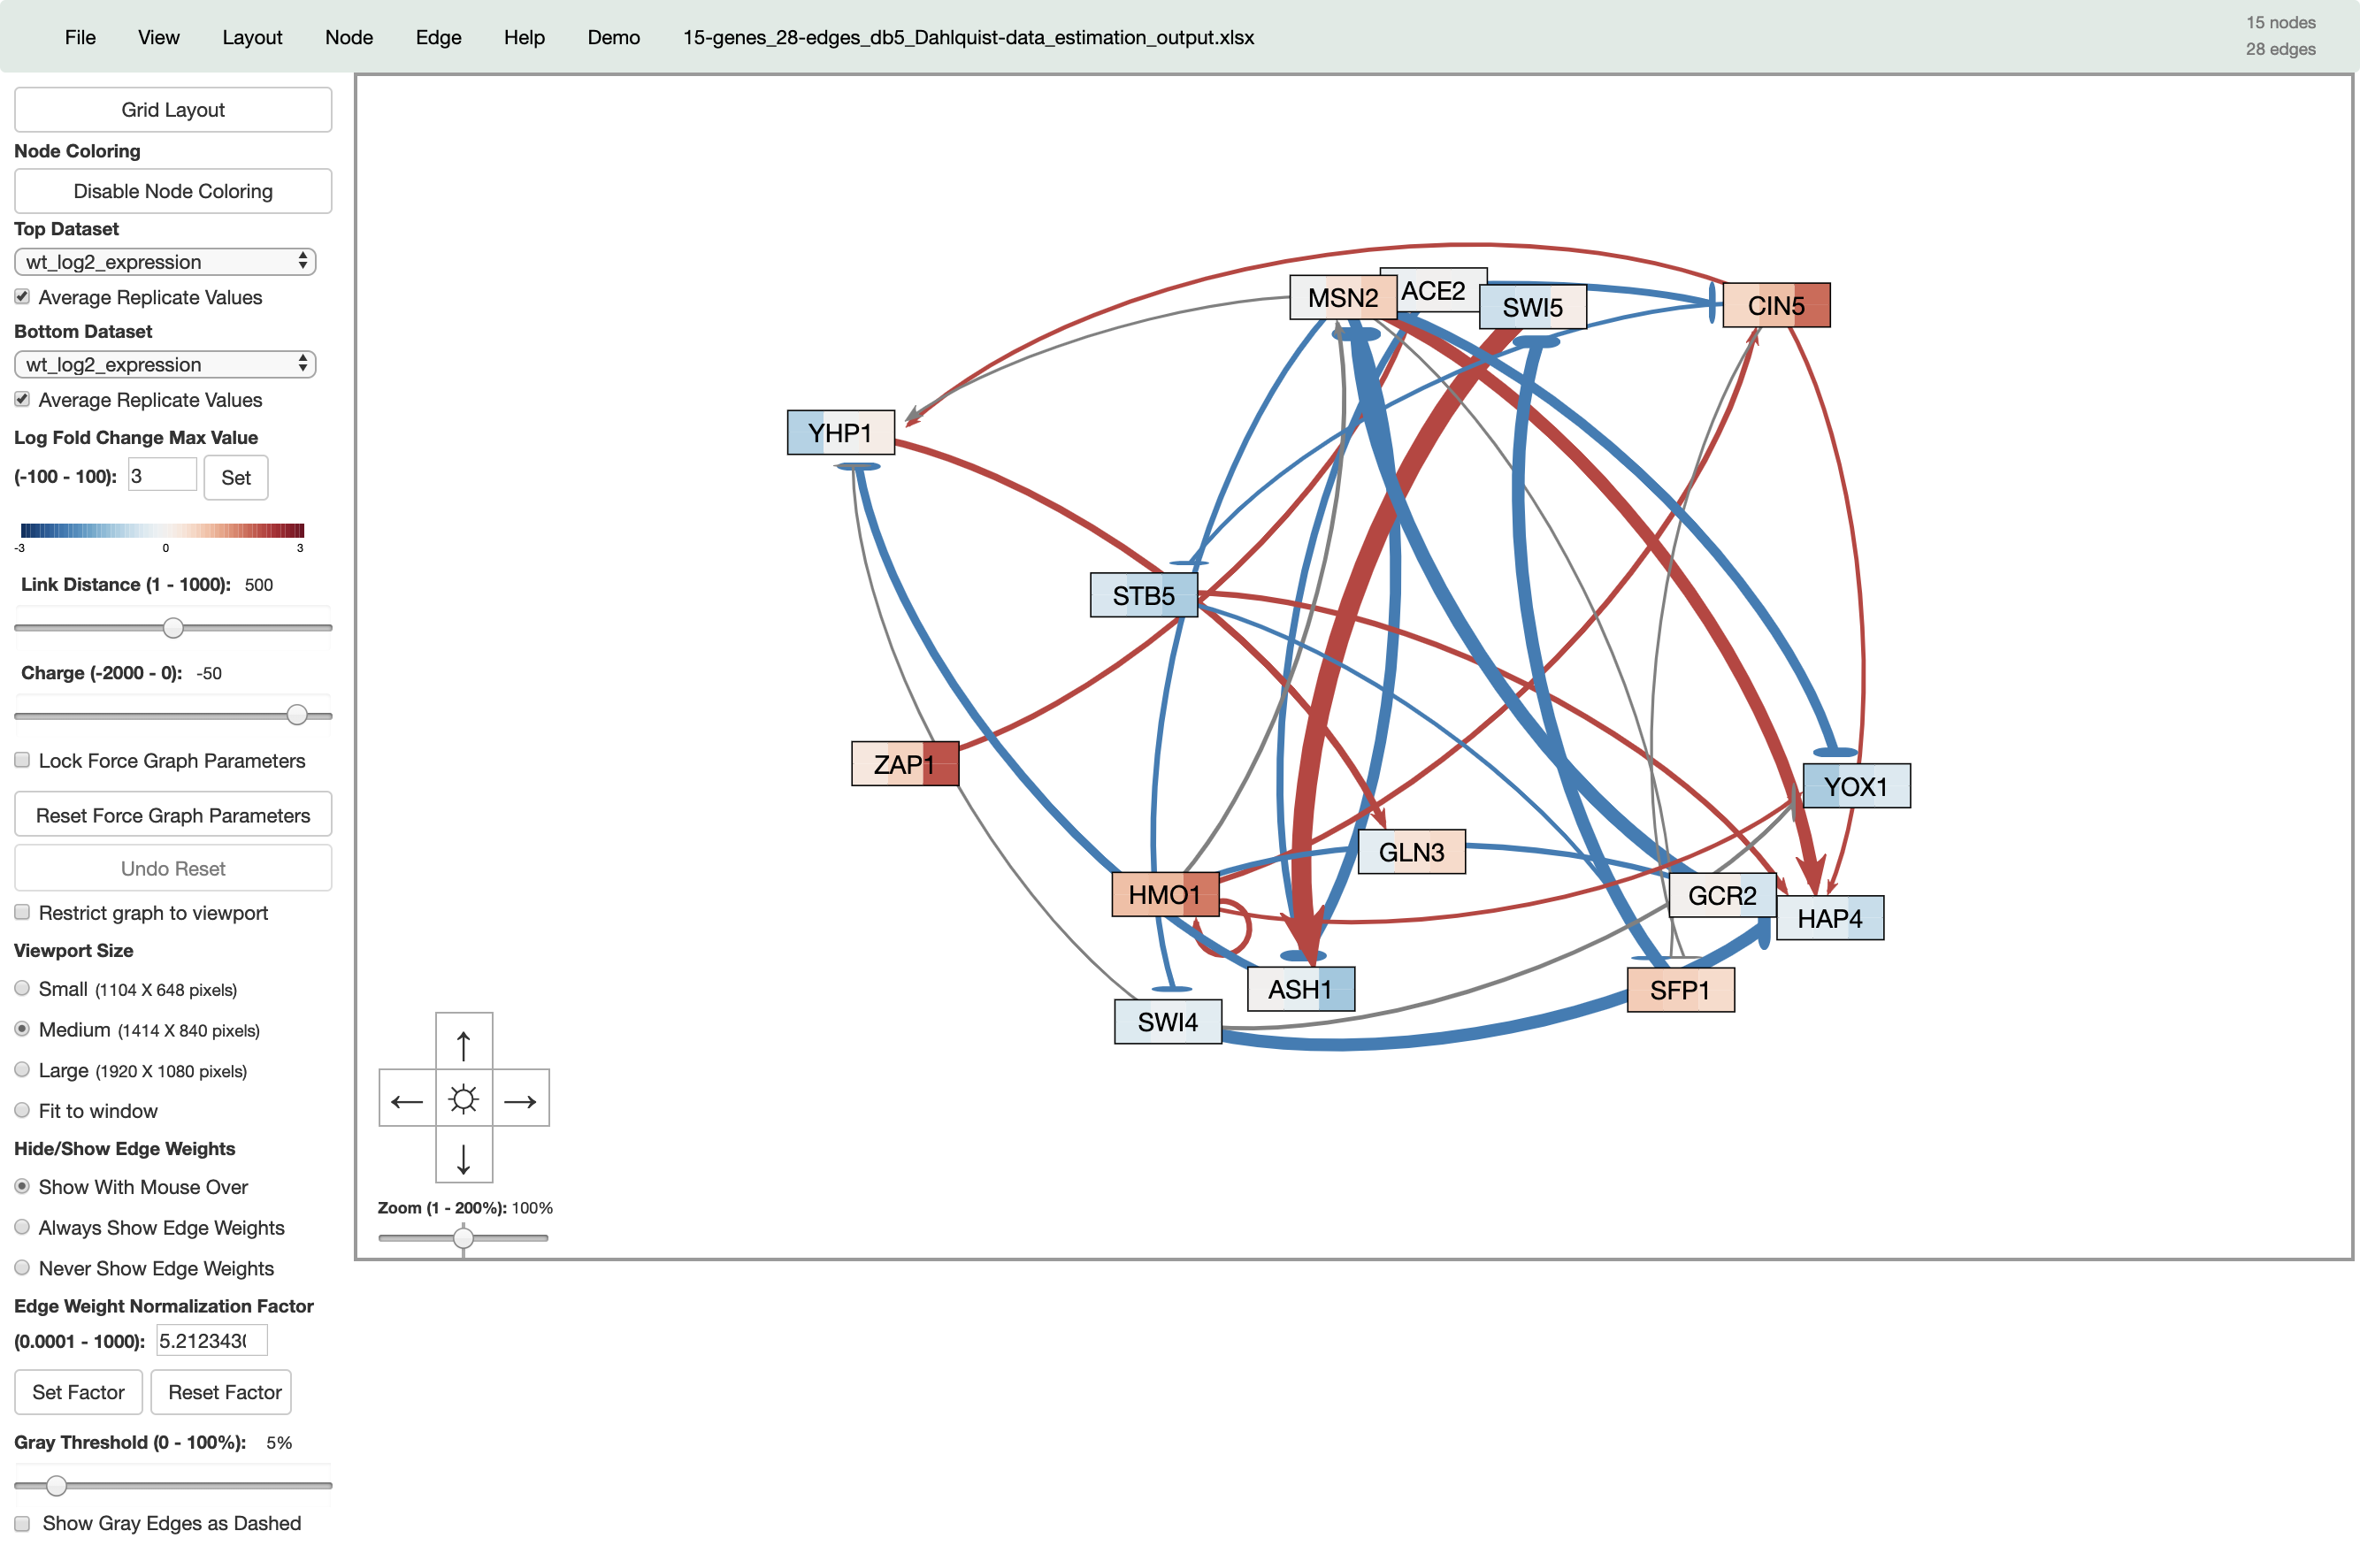
90% of the GRNsight codebase now follows a strict MVC architecture
User-inputted parameters
(completely refactored to MVC)
Graph physics controlled by d3.js
(refactor upcoming)

Slide 30
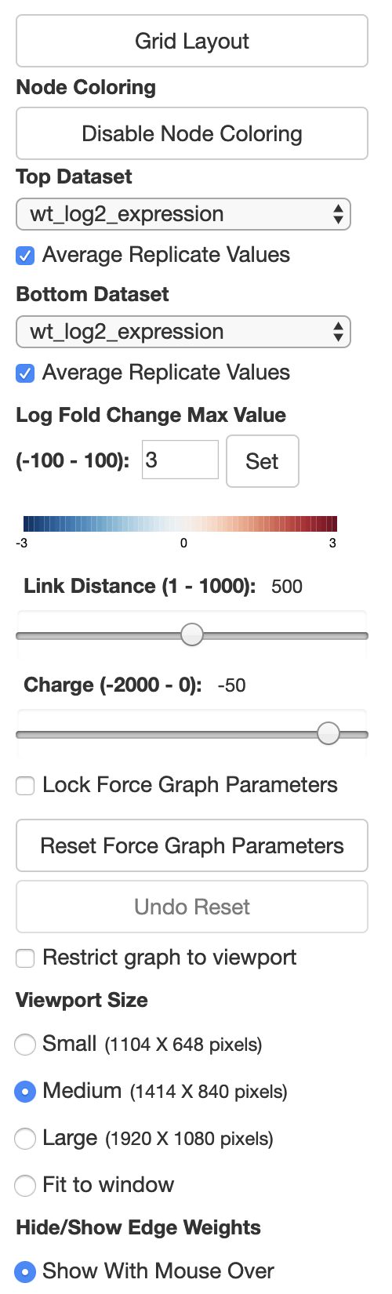
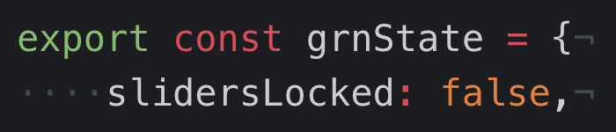
The MVC refactor is “under the hood,” and is seamless to the user
Locking Force Graph Parameter Sliders
Model
Updates
Manipulates
View
Controller
Displays To
Uses
User

Slide 31
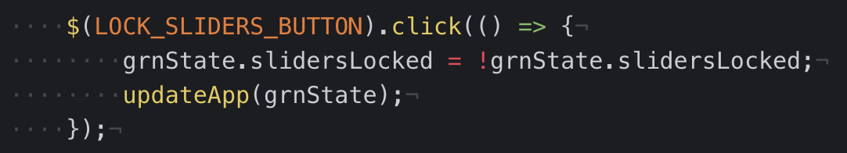
The MVC refactor is “under the hood,” and is seamless to the user
Locking Force Graph Parameter Sliders
Model
Updates
Manipulates
View
Controller
Displays To
Uses
User

Slide 32
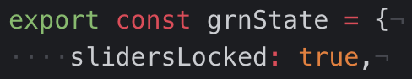
The MVC refactor is “under the hood,” and is seamless to the user
Locking Force Graph Parameter Sliders
Model
Updates
Manipulates
View
Controller
Displays To
Uses
User

Slide 33
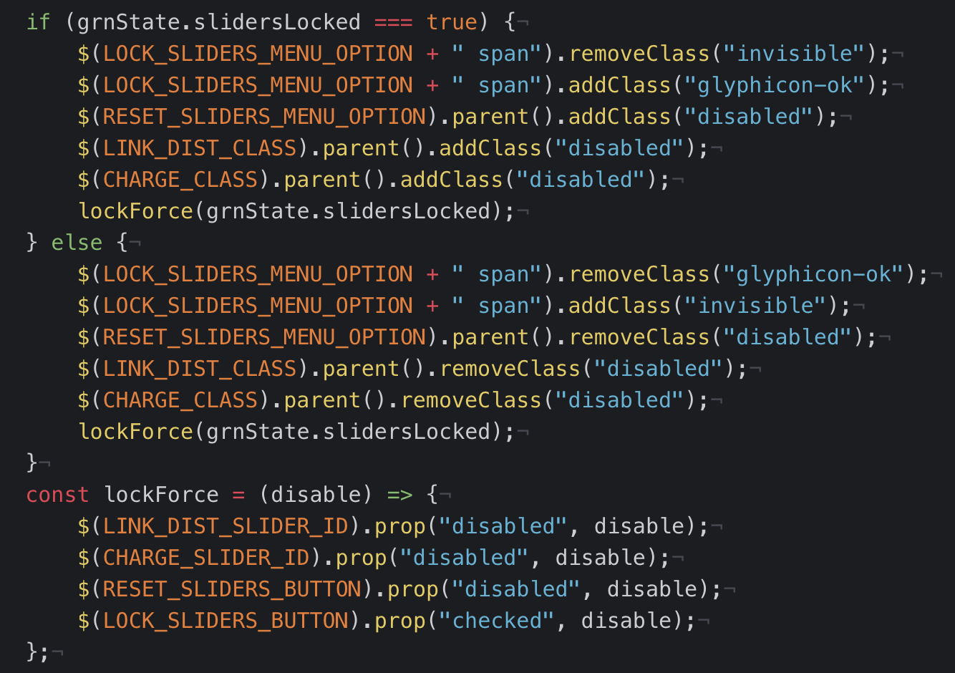
The MVC refactor is “under the hood,” and is seamless to the user
Locking Force Graph Parameter Sliders
Model
Updates
Manipulates
View
Controller
Displays To
Uses
User

Slide 34
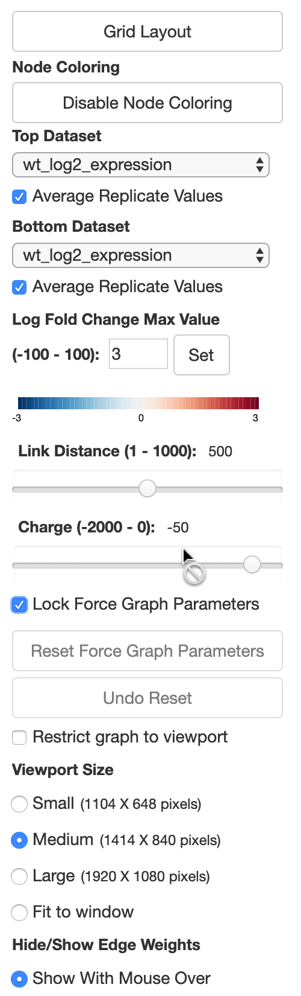
The MVC refactor is “under the hood,” and is seamless to the user
Locking Force Graph Parameter Sliders
Model
Updates
Manipulates
View
Controller
Displays To
Uses
User

Slide 35
Conclusion
GRNsight is an open source web application and service for visualizing models of gene regulatory networks.
GRNsight has matured since version 1.0, adding 13 new features, and expanding its codebase by over 10 times.
This necessitated refactor of 90% of GRNsight’s codebase to the Model-View-Controller paradigm, leading to significantly smoother developer and user interactions
Notes:
Tweak conclusion to emphasize more of what I said
13 new features!
90% of code refactored!

Slide 36
GRNsight application and code are available under the open source BSD license
http://dondi.github.io/GRNsight/
https://github.com/dondi/GRNsight
Current and future work documented via Github Issues
Move graph.js to MVC
Import networks from gene databases
Automate the creation of GRNmap workbooks

Slide 37

Acknowledgements
GRNsight Team
Alexia Filler
John Lopez
Justin Kyle Torres
GRNmap Team
Lauren Kelly
Wet Lab Team
Genesis Cruz
Dr. Kam D. Dahlquist
Dr. John David N. Dionisio

